Slide 1
Copywriting
Some observations
Una Carmody Arts Audiences

Slide 2
Guardian readers’ most disliked words in arts copy

Slide 3
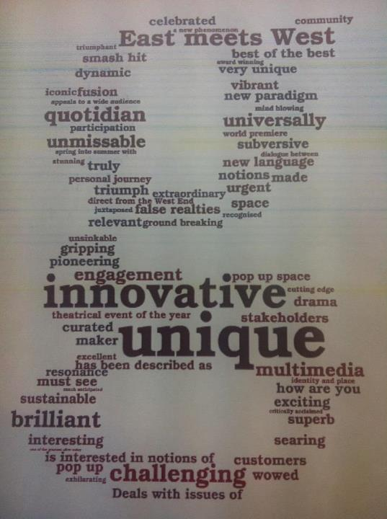

Slide 4
Some tips
Avoid hyperbole
E.g Award-winning (unless it’s an Oscar!)
Reference the experience, not the description
A funny and poignant
story of a father turned
reluctant superhero

Slide 5
Some tips
Referenced copy
If you liked “The Wind that Shakes the Barley” you will love......

